Slide 1

Detection of harmful algal blooms of Karenia Mikimotoi using MODIS measurements
Under the Esteemed Guidance of Submitted By:
Dr. N.V.K Ramesh 190040030
A. Venkata Sai Rishitha
190040033 A. Sasi Keerthi
190040044 B. Gnana Deepika

Slide 2
CONTENTS
Abstract
Introduction
Consequences
Literature Survey
Observations
References

Slide 3
Orgin of the project
Algal bloom events resulting deleterious effect on water quality have been reported in high numbers in Indian waters (D’ Silva et al. 2012).
Blooms of phytoplankton groups such as diatoms, dinoflagellates, cyanobacteria, raphidophytes and haptophytes have been reported from coastal waters of the Arabian Sea and Bay of Bengal.

Slide 4
ABSTRACT
ABSTRACT
As of today, sea cage culture and farming fish in oceans become mandate of the nation under Blue economy goals through blue revolution. The success of cage culture depends on maintaining good water quality around the fish cages and so it is in the farmer’s best interests to minimize environmental impacts.
A Machine learning method is used to estimate the Sub surface temperature (ST) in the Indian Ocean from a suite of satellite remote sensing measurements. These include sea surface temperature(SST), sea surface height (SSH), and sea surface salinity (SSS). It is proposed that using the multisource sea surface parameters to establish a monthly machine learning model to reconstruct the ocean subsurface temperature (ST) and use Argo data for accurate validation.To derive HAB booms maps over the Indian ocean using MODIS satellite imagery data

Slide 5
INTRODUCTION
A rapid growth of microscopic algae or cyanobacteria in water, often resulting in a colored scum on the surface. Along coastal regions and in freshwater systems, agricultural, city, and sewage runoff can cause algal blooms. Algal blooms, especially large algal bloom events, can reduce the transparency of the water and can discolor the water.
Blooms are usually of green, yellow or red in colour. The process of discoloration occurs due to the increase in concentration of pigmented cells in water. Moreover, algal bloom is formed because of various nutrients like nitrogen, phosphorus which enters into the aquatic system through various fertilizers.

Slide 6
Consequences of Algal Bloom
According to scientists, increasing temperature due to global warming has contributed to the growth of harmful algal bloom. The high temperatures break down nutrients in water bodies which are then easily consumed by algae causing them to excessively proliferate.
An algal bloom is generally observed where the water resources are still. For example, ponds or where aquaculture is done in the limited space, the chances of algal bloom increases. A large amount of water with no disturbance causes a massive increase in algal growth.

Slide 7
Literature Survey
S.No | Author | Title | AIM | HAB Species | Method/Procedure
1 | Eko Siswanto | Detection of harmful algal blooms of Karenia mikimotoi using MODIS measurements: A case study of Seto-Inland Sea, Japan | Based on MODIS and in situ data collected in the coastal region of the western part of Seto-Inland Sea, Japan with HAB-forming algae Karenia mikimotoi, a simpler new satellite remote sensing-based HAB detection method was developed | 1.Karenia mikimotso | Moderate Resolution Imaging Spectroradiometer (MODIS)
2 | Elamurugu Alias Gokul and Palanisamy Shanmugam | An optical system for detecting and describing major algal blooms in coastal and oceanic waters around India | An optical system is developed with the aim to detect and monitor three major algal blooms to strengthen algal forecasting system | 1.e Noctiluca scintillans/miliaris 2.Trichodesmium erythraeum 3.Cochlodinium polykrikoides | Moderate Resolution Imaging Spectroradiometer (MODIS)

Slide 8
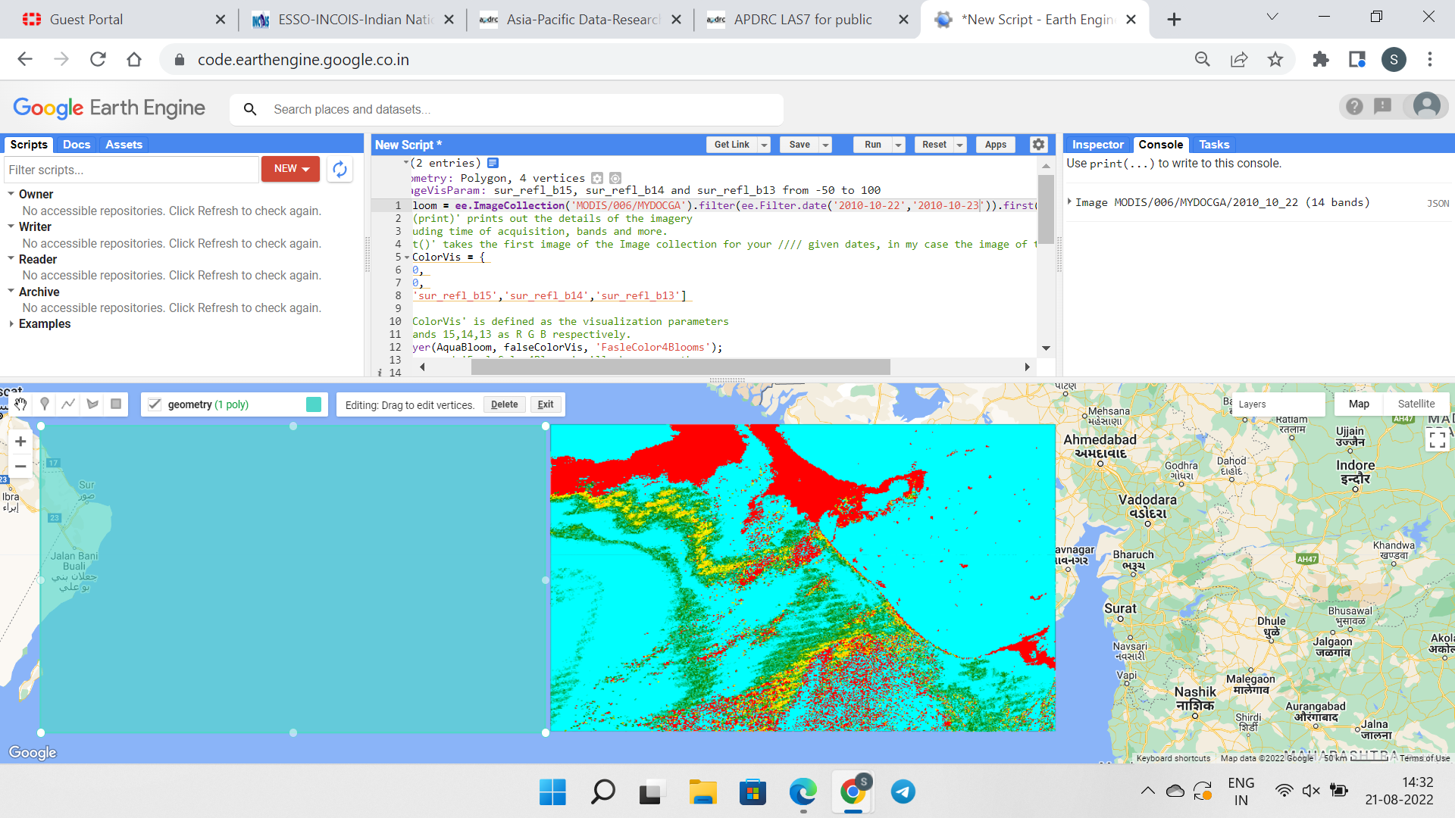
OBSERVATIONS

Slide 9
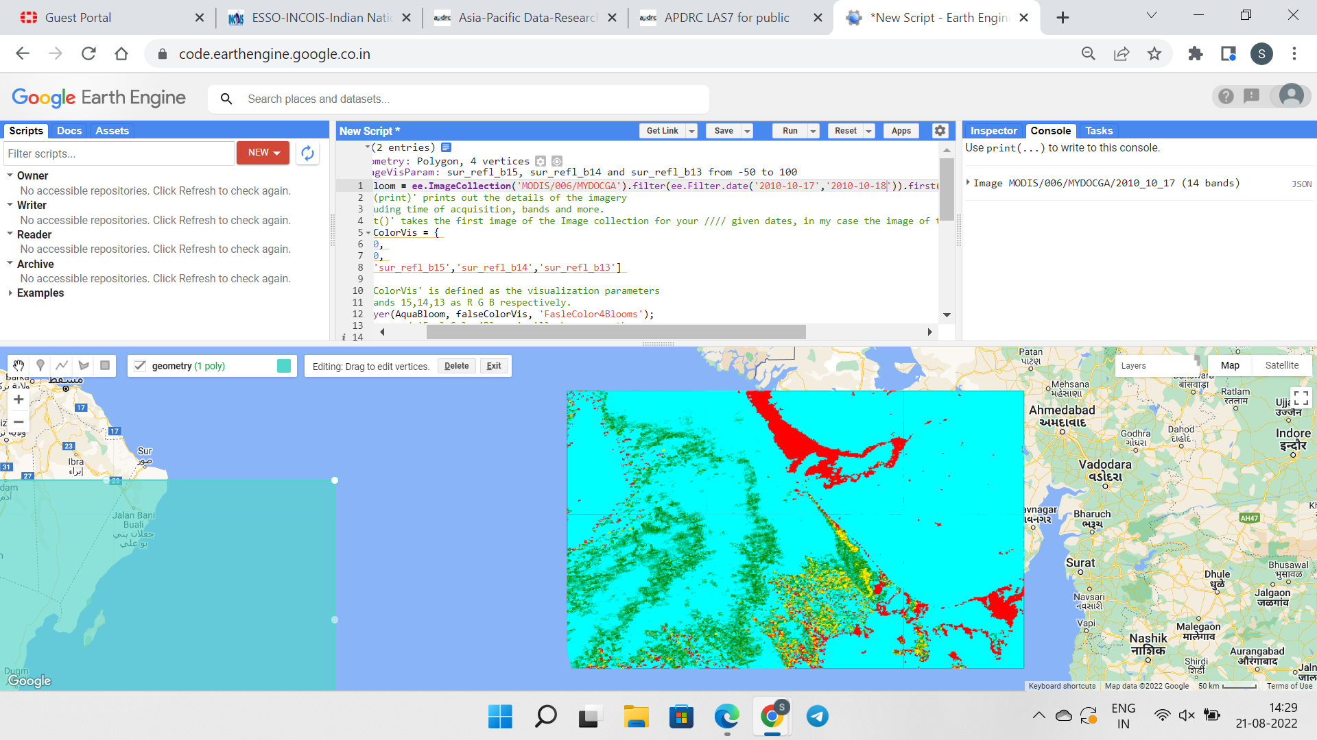

Slide 10
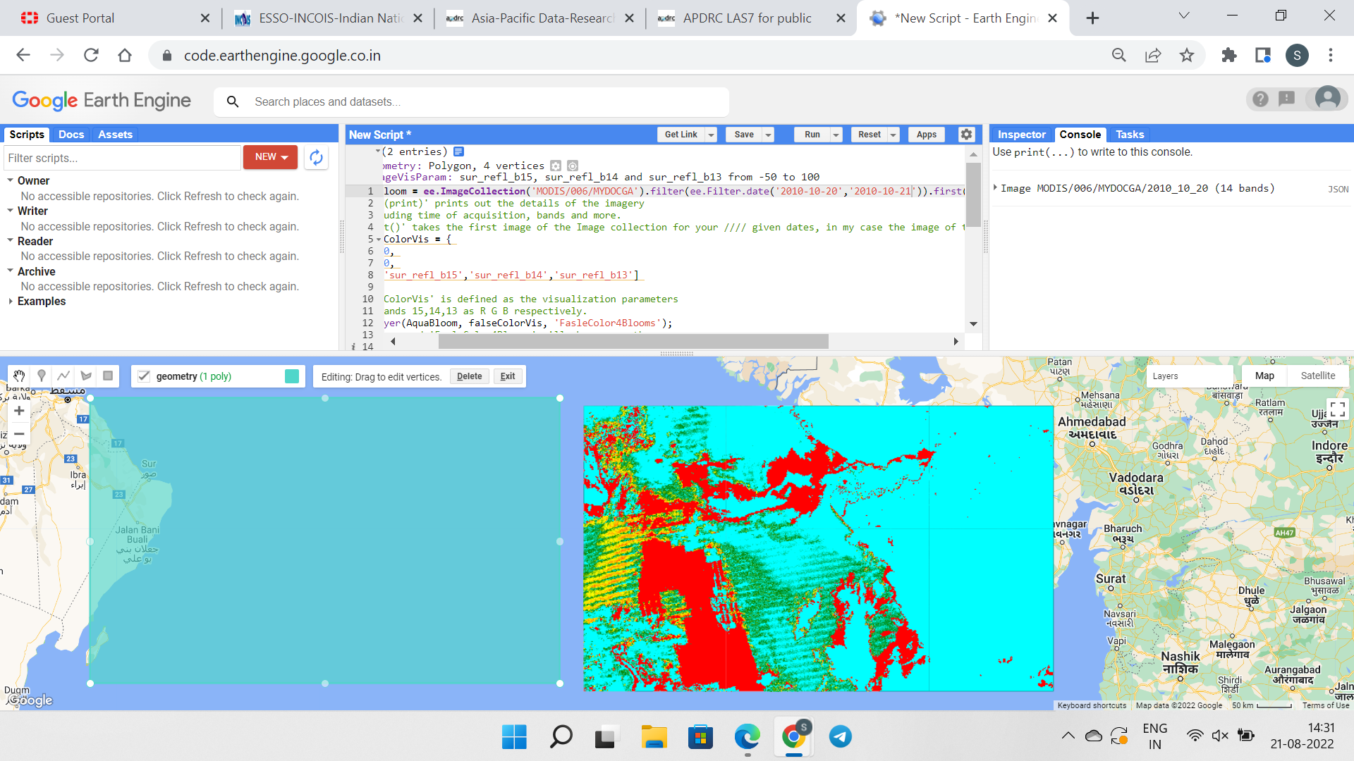

Slide 11
REFERENCES
AFCD, 2020. History of red tide/HAB in Hong Kong. https://www.afcd.gov.hk/english /fisheries/hkredtide/redtide/red03.html. (Accessed: 28 Dec 2020).
Berfanger, D.M., George, N., 1999. All-digital ring-wedge detector applied to fingerprint recognition. Appl. Opt. 38, 357–369. https://doi.org/10.1364/ao.38.000357.
Blauw, A.N., Anderson, P., Estrada, M., Johansen, M., Laanemets, J., Peperzak, L., Purdie, D., Raine, R., Vantera, E., 2006. The use of fuzzy logic for data analysis and modelling of European harmful algal blooms: Results of the HABES proje
Devred, E., S. Sathyendranath, V. Stuart, H. Maas, O. Ulloa, and T. Platt (2006), A two component model of phytoplankton absorption in the open ocean: Theory and applications, J. Geophys. Res., 111, C03011, doi:10.1029/2005JC002880.
Gomes, H. D. R., J. I. Goes, S. G. P. Matondkar, S. G. Parab, A. R. N. Al-Azri, and P. G. Thoppil (2008), Blooms of Noctiluca miliaris in the Arabian Sea—An in situ and satellite study, Deep Sea Res., Part I, 55, 751–765, doi:10.1016/j.dsr.2008.03.003.
Gower, G. A., J. F. Borstad, and E. J. Carpenter (1992), Development of Algorithms for Remote Sensing Of Trichodesmium Blooms, Mar. Pelagic Cyanobacteria: Trichodesmium Other Diazotrophs, 362, 193–210.

